Slide 1

October 23rd
Pro-d with SD61
Greater Victoria
Pulling Together Equity in Education
Session 2: SmartLearning 2020: the power of rich texts, open tasks and inclusive cognitive processes
Susan Close
Email: susan@susanclose.ca
Twitter: @susanclose5
Patricia Pain
Email: patriciamarie@susanclose.ca
Twitter: @patriciampain

Slide 2

Land Acknowledgment
The Greater Victoria School District wishes to recognize and acknowledge the Esquimalt and Songhees Nations on whose traditional territories we live, we learn, and we do our work. We would also like to acknowledge that Susan and I are on this journey with you today, with deep gratitude, from the Musqueam and Kwikwetlem First Nation.

Slide 3
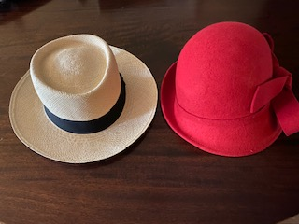
Two-hat thinking: one: educator two: student
♥ one: facilitator two: reflector

Slide 4

What's our story?

Slide 5


Who are you?
Where are you from?
What is your role?
One word to describe how you are feeling today...
Chat Blast!
Type a response in the chat to each of these questions, but don't hit enter until I say go.
We will hit enter at the same time and blast the chat with our responses!

Slide 6
Shape of our Session
Connecting & or Re-connecting with session 1
Living out Day one of a sequence
How is equity achieved?
Where do you we go from here?

Slide 7
Purpose and Intentions:
To show how we can achieve equity through deeper learning.

Slide 8
Why Talk Matters...Structured Talk
included
valued
EQUAL
confident
respected

Slide 9
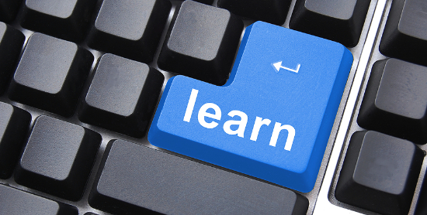


Let's learn by living out a sequence together....

Slide 10
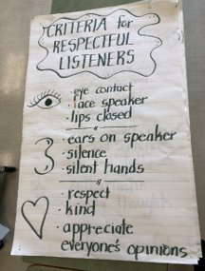
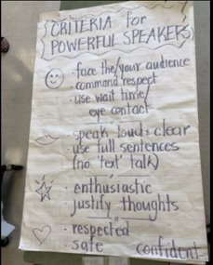
RESPECTFUL LISTENING & POWERFUL SPEAKING​
What do we know about listening respectfully?​
​
What do we know about speaking powerfully?​
How is equity achieved?​

Slide 11

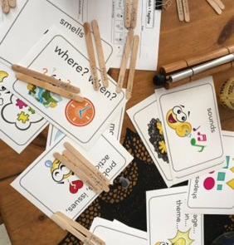
A/B Partners
How is equity achieved?

Slide 12

"We are going to set a goal for today to help our minds think carefully. Our final task today will be to make a prediction about our story.
Let's Set Today's Goal

Slide 13
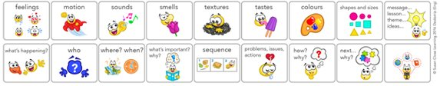
"To help us with this task, we will set a goal to help us focus on what is important to remember. Please circle:
My goal for today is to use the clues I gather and any connections I have, to help me make a logical prediction. I will also justify my thinking.
How is equity achieved?

Slide 14
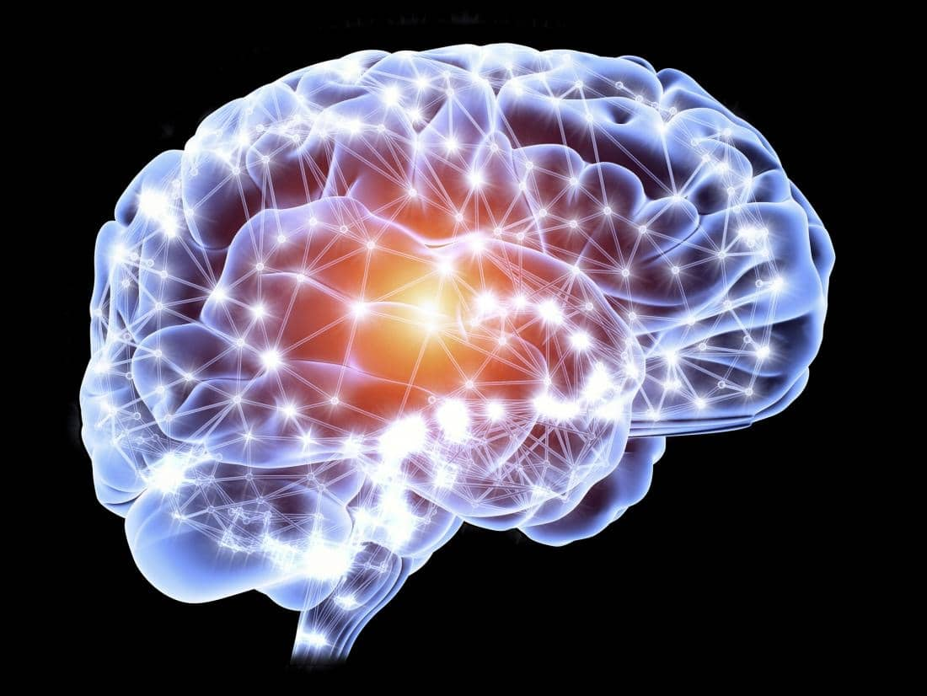

Connecting
to the
Story
Before Reading

Slide 15
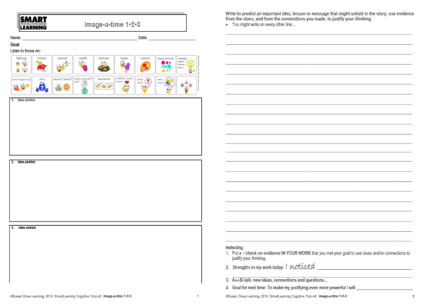
Connecting with: Image a Time
How is equity achieved?

Slide 16
"We are going to activate our prior knowledge by making some connections to clues. We are going to think of three times in our lives in order to help us connect to the story. Here is the first one...
I want you to think of a time when you felt paranoid or nervous.
Draw your image of this and if you’d like, you can add words as well."

Slide 17
"Now let’s think of a time when you witnessed someone planning or plotting to do something wrong.
Draw your image of this and add words if you like."

Slide 18
"Now think of a time when you helped someone to feel accepted OR when someone helped you to feel accepted.
Now let’s meet with our partners to share our ideas and then we will report out."
Students meet for a few minutes, they are then given rehearsal time to report out...
"The time my partner, _________, and I would like to share was when (partner's name) (share 1 of the 3 times here).

Slide 19
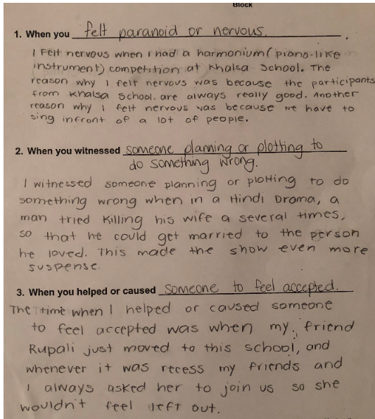
Student Sample:

Slide 20


Processing
(the Story)

Slide 21
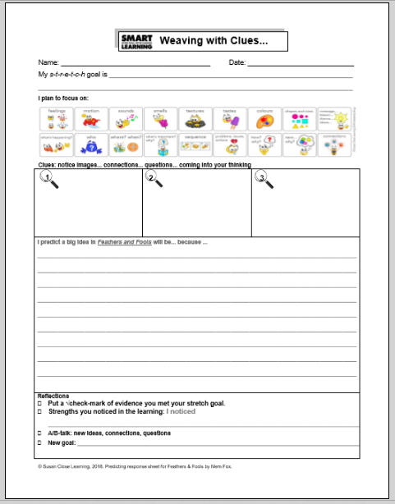
Processing with: Weaving with Clues
How does
this achieve equity?

Slide 22
Example of language...
"It’s time for us to receive some clues about our story. I will share 3 clues, one at a time.​ These clues will help you to connect to the story.
Remember that our goal for today is to use the clues you gather and any connections you have, to help you make a logical prediction. You will justify your thinking every step of the way.

Slide 23
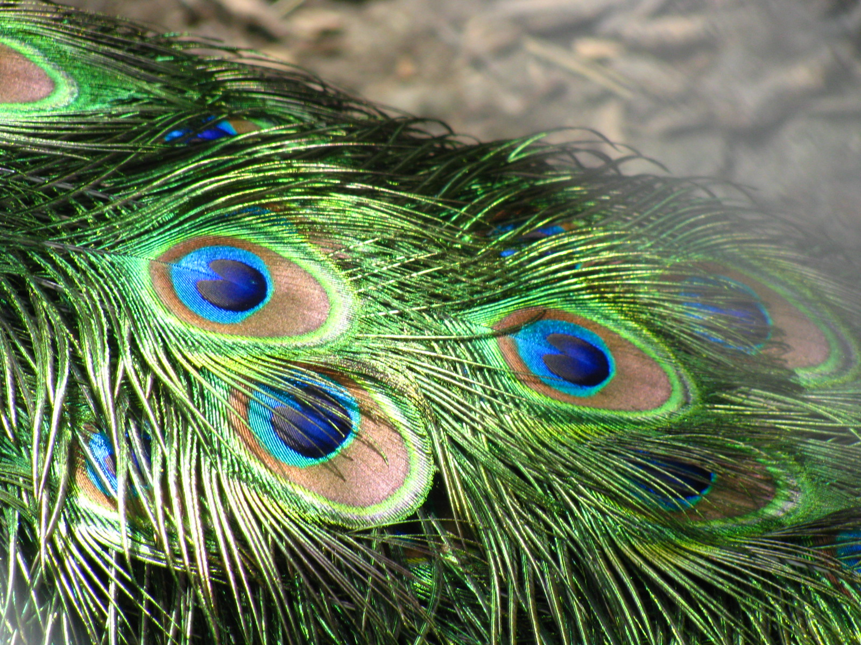
Introducing clues one at a time to build prior knowledge...
"I will share the first clue now, look closely at it​. In a moment I will signal to you to talk to your partner and when you are ready, together you can write/draw your prediction. ​
​
I will stop you to give you time to rehearse and then you will
report out.... look closely at the clue...think about your connections...
​
Clue #1:
When you are ready, talk to your partner about what you think the story might be about​."

Slide 24
Example of language...
"Now it’s time to write your prediction together. Together, use the clue and what you have discussed and record your prediction in box one. In a moment you will report out​..."
(Give students time to write in box 1)

Slide 25
A/B Parter Talk & Reporting Out
"Now that you and your partner have thought and wrote about your prediction, let's rehearse how you will report this out:
"My partner, ________, and I predict_______. We think this because________."
You have two minutes to practice what you would like to say."​
(repeat this process for clues 2 & 3)

Slide 26
Thinking about structured talk...
"Now that you have had time to rehearse, let's report out before we move onto the next clue:​
​
"My partner, ________, and I predict_______. We think this because________."​
​
​
How does
this achieve equity?

Slide 27

Example of language...
"As you receive each new clue, you will notice that your predictions get more sophisticated because you have more to work with…you can even change your mind as long as you justify your thinking! "

Slide 28

Introducing clues one at a time to build prior knowledge...
Clue #2:

Slide 29
Gap Analysis...
Clue #3:
Anxious mutterings
Silence hung over the gardens
Curiosity and trust
Unafraid

Slide 30
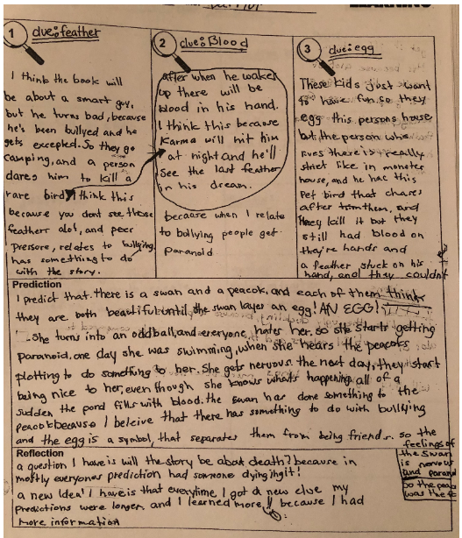
Student Sample:

Slide 31

Questions
How does this build equity?
"It's time to let our minds wonder. We are going to use the popcorn method to share our thinking. If you hear something that triggers a question for you, pop up like popcorn and share."​:
What are you wondering?​
What are you most curious about?​
Why do you wonder this?​"

Slide 32

Transforming our
Learning
After Reading

Slide 33
End of Day 1 Final Task
What do you predict will be the big idea/message in this story?

Slide 34
T-chart
"Before we begin to make predictions, we need to brainstorm what makes a prediction powerful.​What kinds of things do powerful predictors include in their predictions?​
Let’s use this t-chart to record our ideas​. You will be able to use this chart when you write your predictions today​.
You have 2 minutes to talk to your partner about what makes a powerful prediction. When you’re ready, we will co-create the list together​."
How does
this achieve equity?

Slide 35
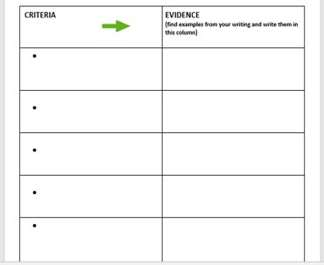
T-chart

Slide 36
End of Day 1 Final Task
"It’s now time to use everything we’ve done today to help us create a prediction​. You have already started predicting today when we did Weaving with Clues and Image a Time, but now you will take it to writing. In a moment, you will stand up and talk with your partner one more time​. Use the t-chart we created to help you with your prediction​. Go ahead and discuss with your partner and when you’re ready you can co-create one powerful prediction​.
You will have 3-4 minutes to talk. You may begin...."

Slide 37
Setting the Image
You are about to begin your response to today's final task. Now, you are about to predict the big idea or message in the story.
Notice where you are in the story. Notice the peacock feather. Notice the feeling. Notice the vibrant colours. Notice the blood. Feel the blood. Picture the blood. Notice the words: anxious mutterings. What does that sound like? What is the feeling? Notice the words: silence hung over the garden. What does that look like? Notice the words: curiousity and trust. Who is curious? Who can be trusted? Notice the word: unafraid. Who is unafraid? Why are they unafraid?
Remember that you have been gathering everything that you need for this write. You may use everything you have.
You may begin...

Slide 38
Responding to their Final Task
"As I move about I am going to tap you on the shoulder and invite you to read your beginning​. Hearing ideas is like a fuel pump for thinking​. As you are writing feel free to cross out words and add new words​. If you don’t like your beginning, put an X and start again​. Writers start, stop and then start again​. Each time they get closer to what they really want to say​. Once you are done your writing, I will collect them​. Overnight I will highlight powerful phrases and we will use this to re-connect with our story." ​
​

Slide 39
Student Sample:

Slide 40


Reflecting on the Learning
"It’s now time to reflect on the learning we did today…”
1. Put a check on evidence you met your goal.
2. Strengths I noticed in my learning: I noticed….
3. A↔B: new ideas… new connections… new questions…
4. Goal:
Thank you for your hard work today!

Slide 41
A little more about rich tasks..

Slide 42


Task Analysis & Goal Setting
How does this achieve equity?

Slide 43
Task Analysis & Goal Setting
How does this achieve
equity?
"We are going to set our s-t-r-e-t-c-h goal for reading today​. Goal setting is a very important skill for readers to develop. Good readers do this automatically to help them understand the story better​.We will need to use our final task to help us set a goal – let’s look at how we do this​"

Slide 44
Task Analysis & Goal Setting
How does this achieve equity?
"Setting our goal by using our final task is like a hamburger. The top bun is our final task and the bottom bun is our goal. Everything in the middle is the story. Let’s do a task analysis by looking at what the task is asking us to do…"

Slide 45
Task Analysis & Goal Setting
"Here is your final task..."
Write to show who you believe to be the fool in this story. Write in role as either a peacock or swan to show what you have learned from this terrible mistake and why you believe this foolish mistake happened.
Remember to justify your thinking!
How does this achieve equity?

Slide 46
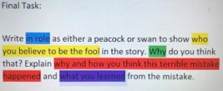
Task Analysis & Goal Setting
How does this achieve equity?

Slide 47
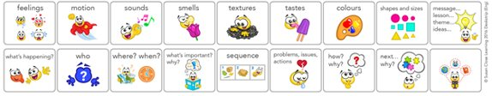
Task Analysis & Goal Setting
"Now let’s look at our icon strip and match the criteria to the icons we will focus on while we read​."
​
How does this achieve equity?

Slide 48
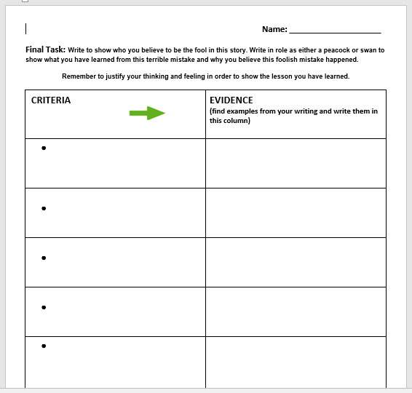
T-chart & Task Analysis
It’s time to shift our focus to writing now. Together, we are going to co-create the criteria for powerful writing. You may copy this down in your t-chart. First, let's do another task analysis to remind ourselves of what the task is asking us to do...

Slide 49
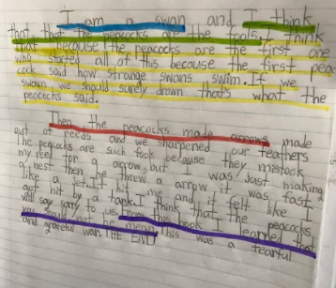
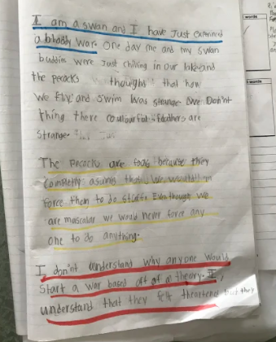
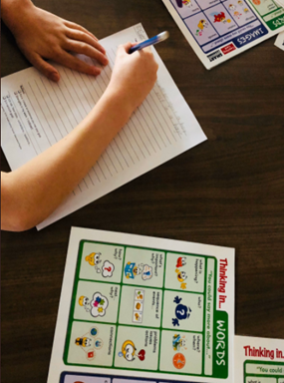
T-chart & Task Analysis
How does this build equity?

Slide 50

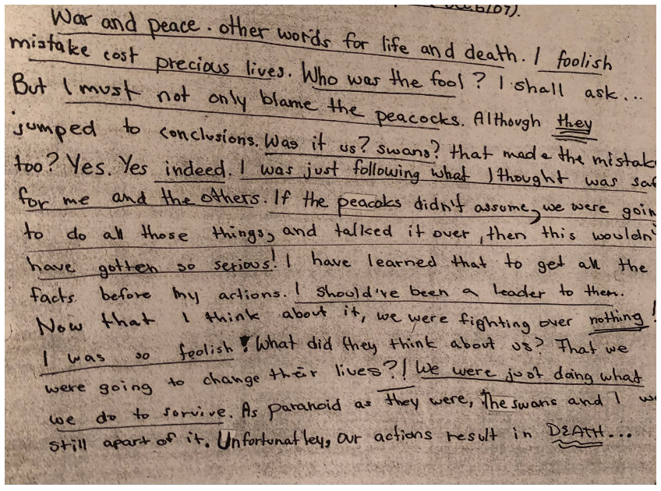
Student Sample:

Slide 51
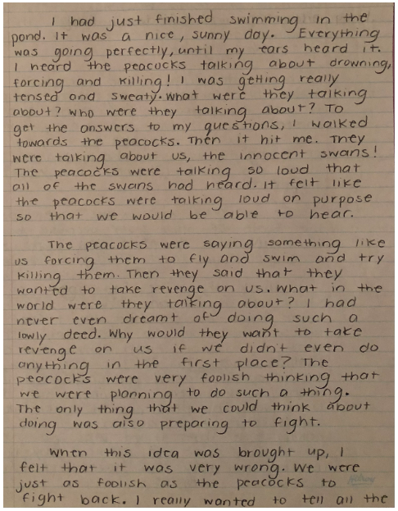
Student Sample:

Slide 52
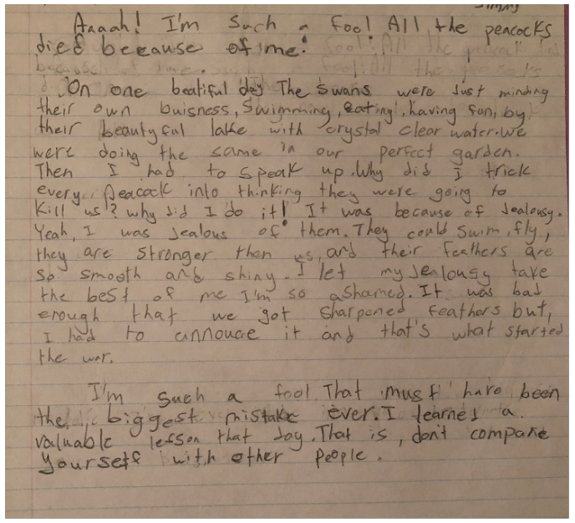
Student Sample:

Slide 53
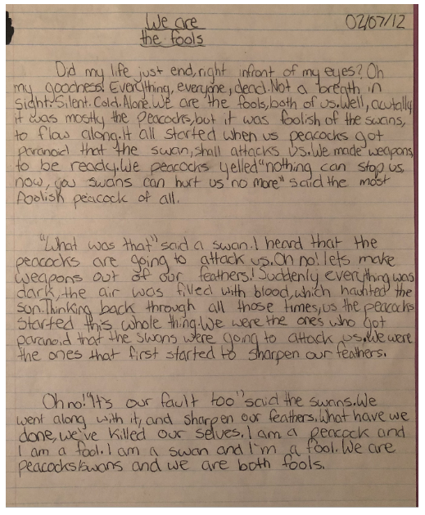
Student Sample:

Slide 54
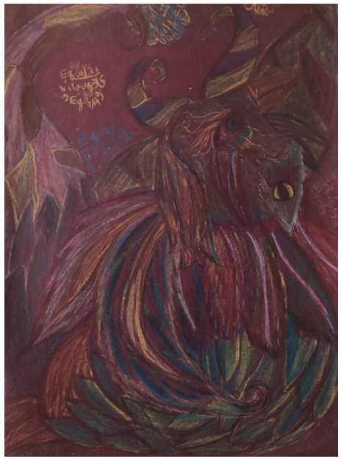
Extension
Activity

Slide 55
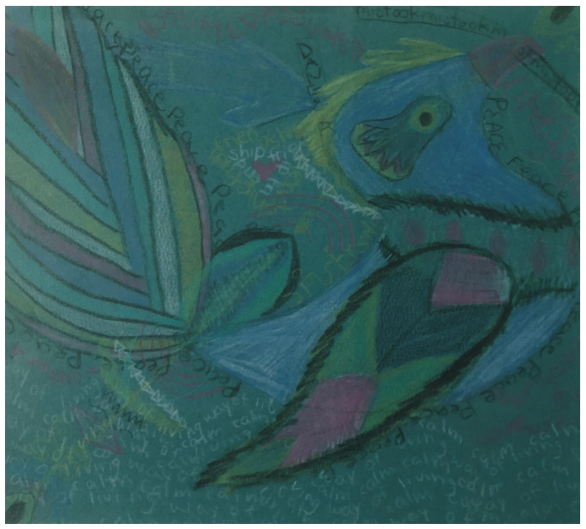
Extension
Activity

Slide 56
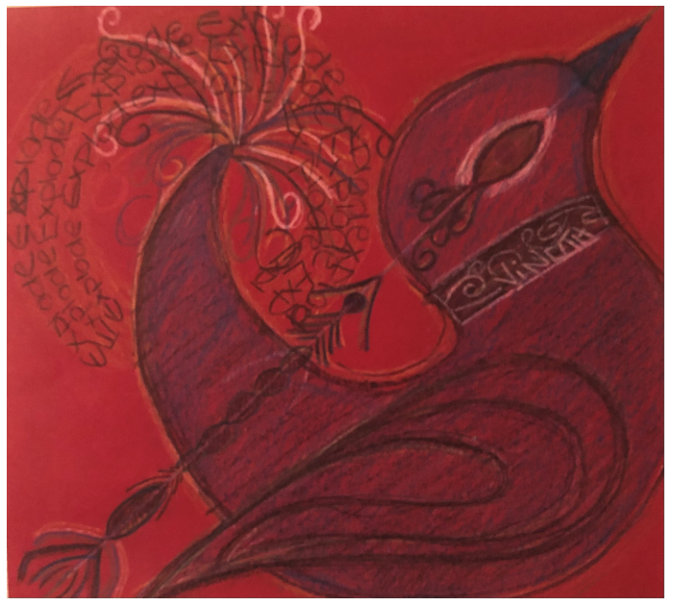
Extension
Activity

Slide 57
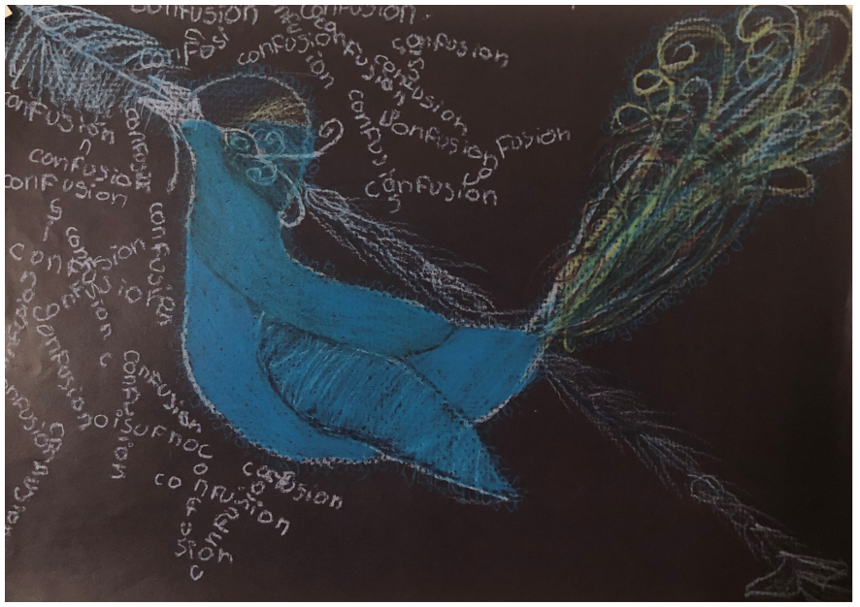
Extension
Activity

Slide 58

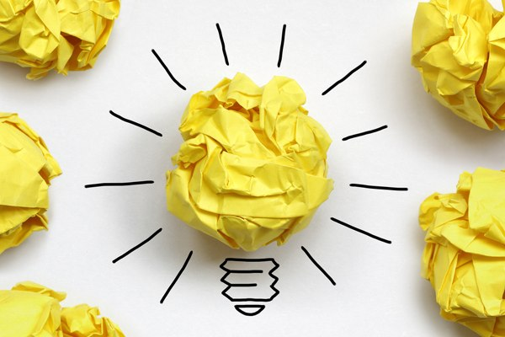

Reflect:
Q & A
Moving forward...
What is something new you learned today about equity and learning?
What is a takeaway you will move forward with?
What are you wondering about?

